Slide 1
GEOG-G489/589 Advanced Geospatial Data Analysis in Python
Instructor: Natasha MacBean
Introduction to Pandas

Slide 2
Notice: Wednesday Office Hours changing to 12:00 – 1.00pm
Please email me if beforehand if you’re going to come to office hours.

Slide 3
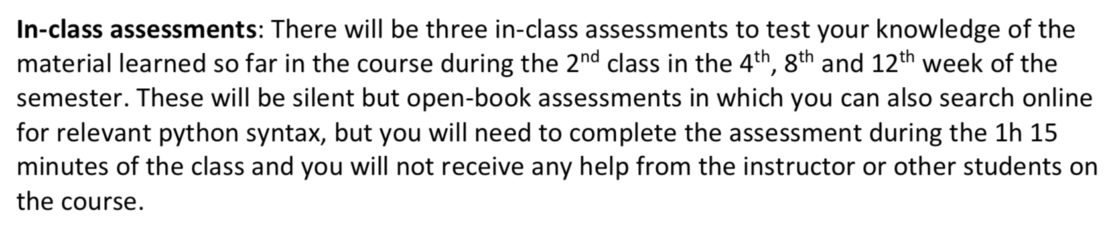
Reminder! In-class assessment this time next week.

Slide 4
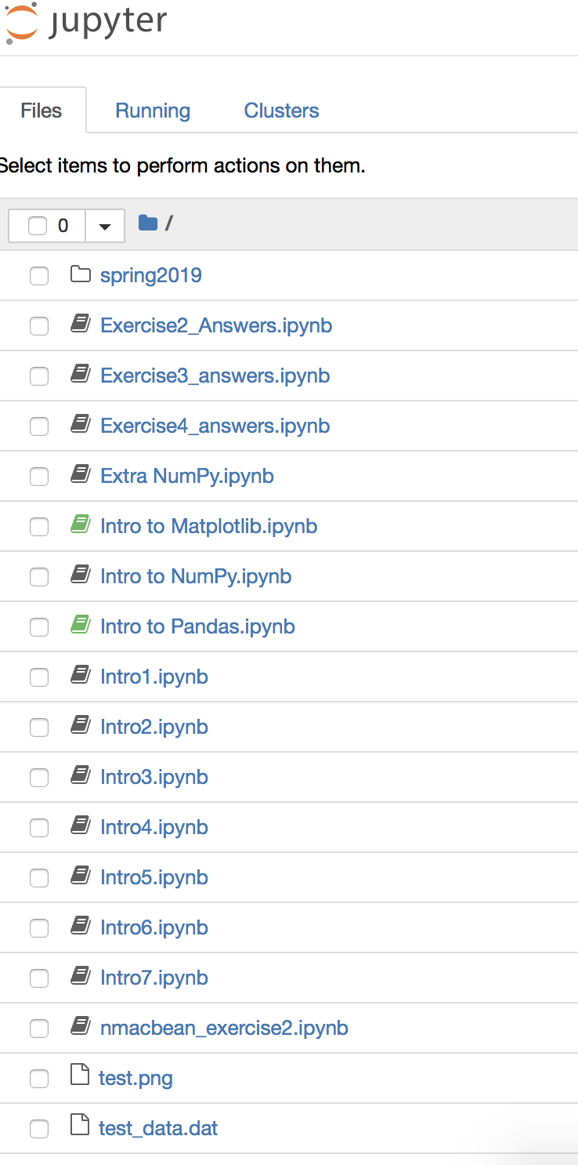
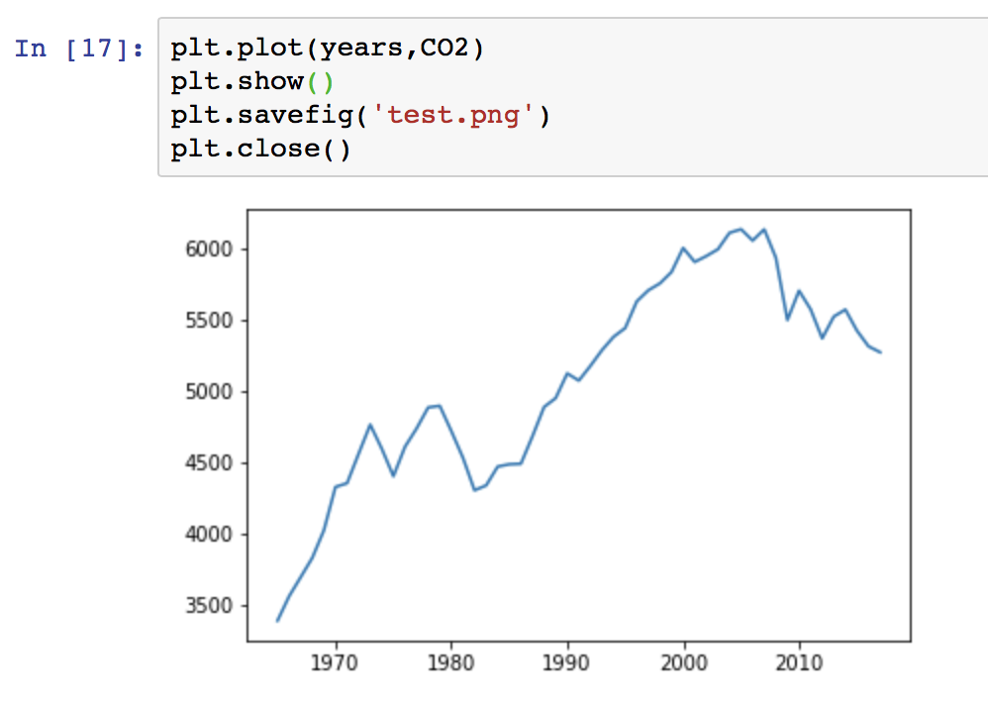
Extra Maplotlib
plt.savefig()
plt.close()

Slide 5
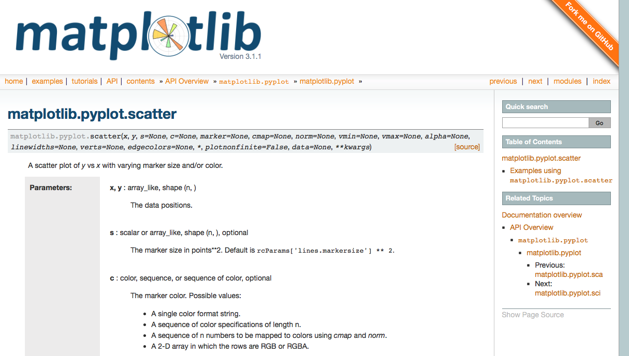
Looking up a function

Slide 6
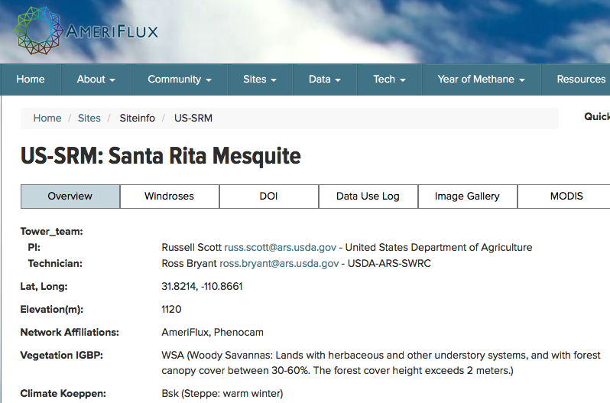
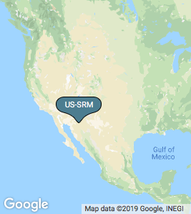
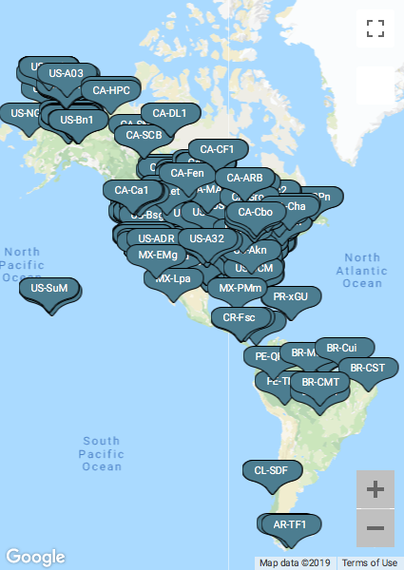
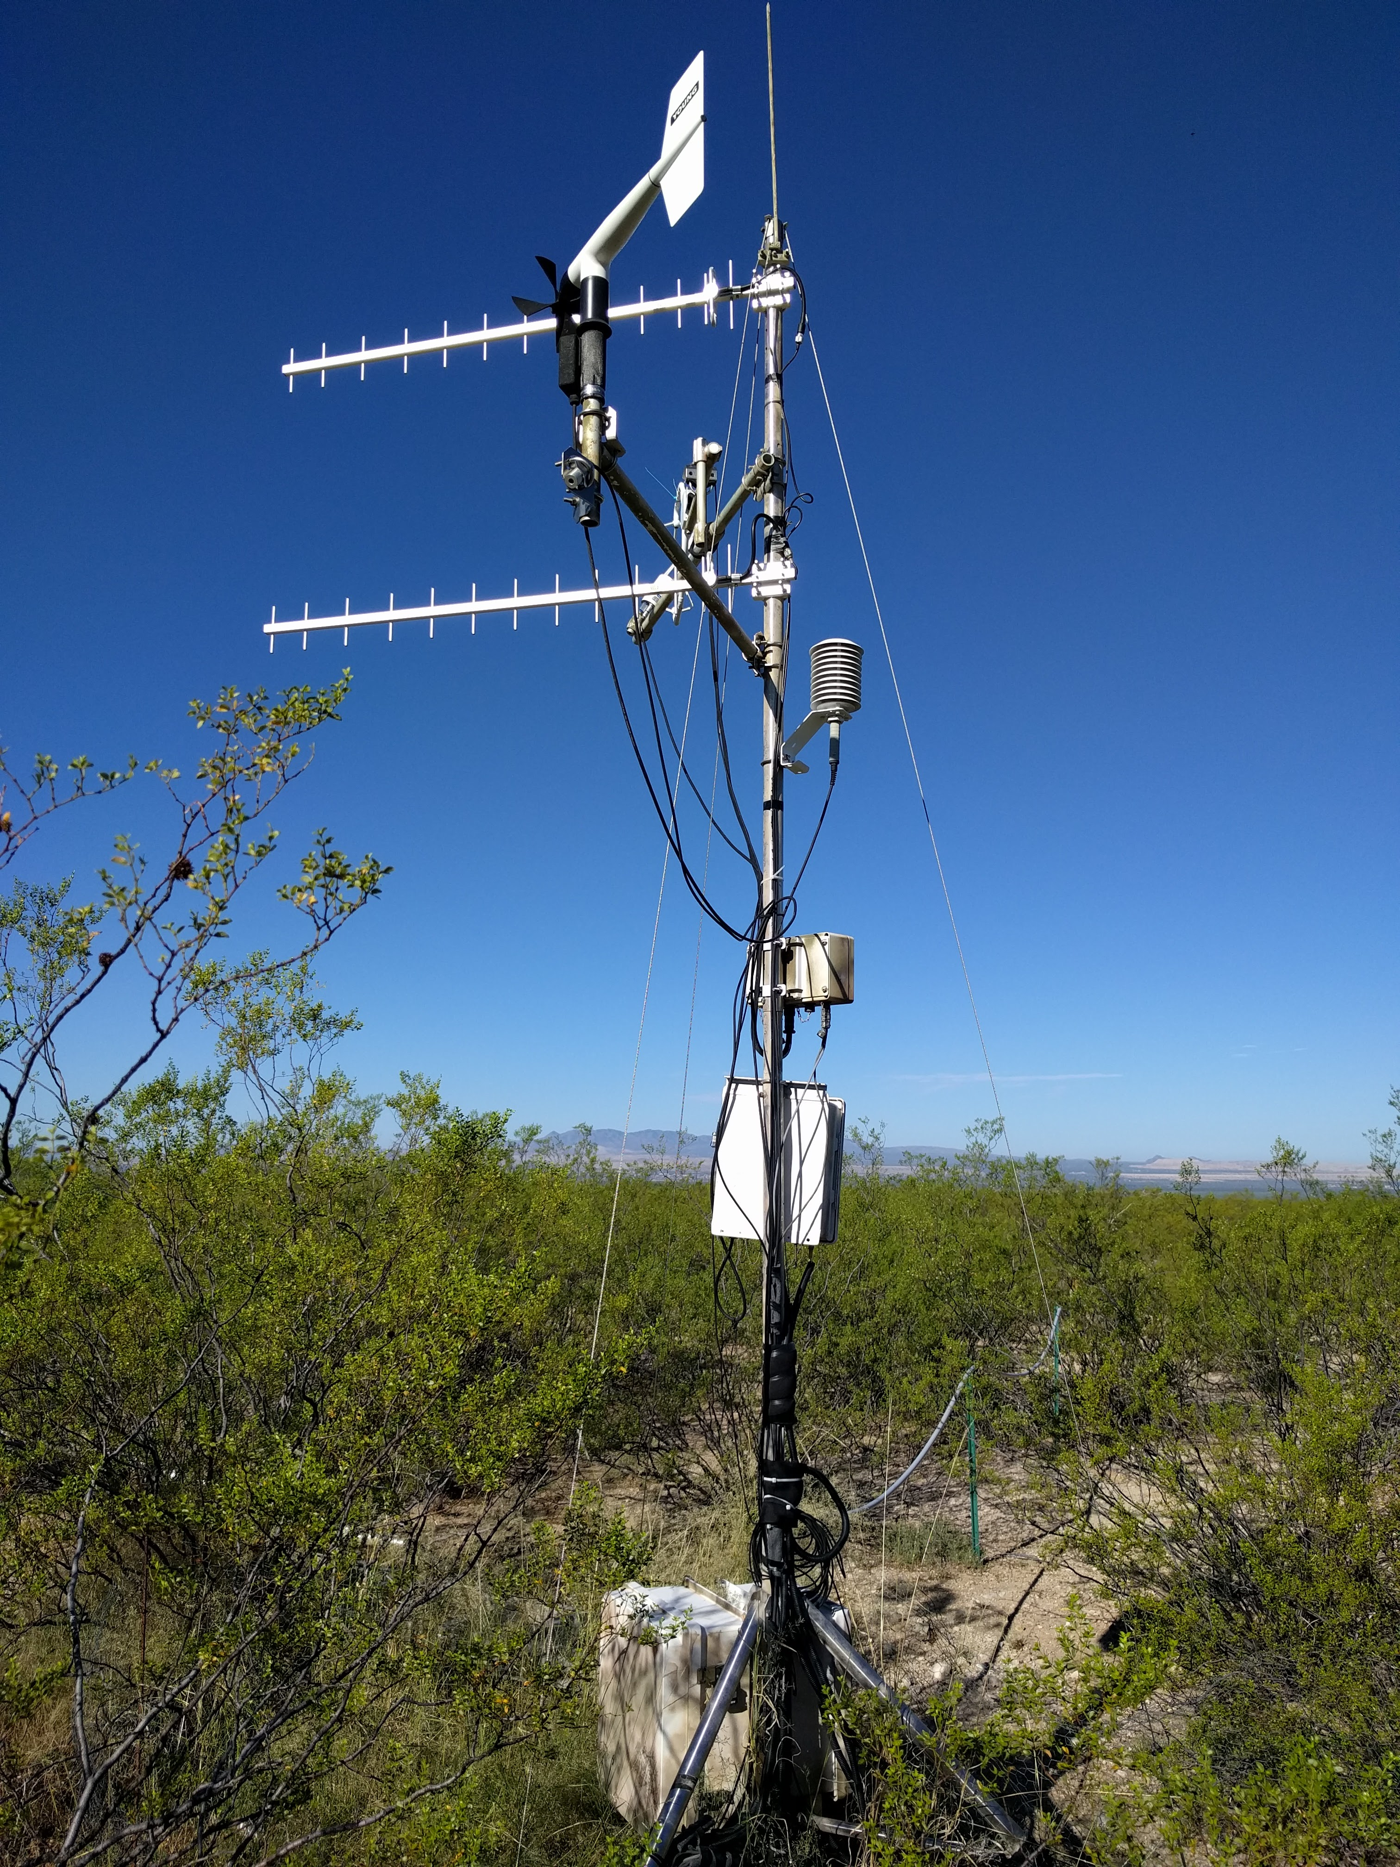
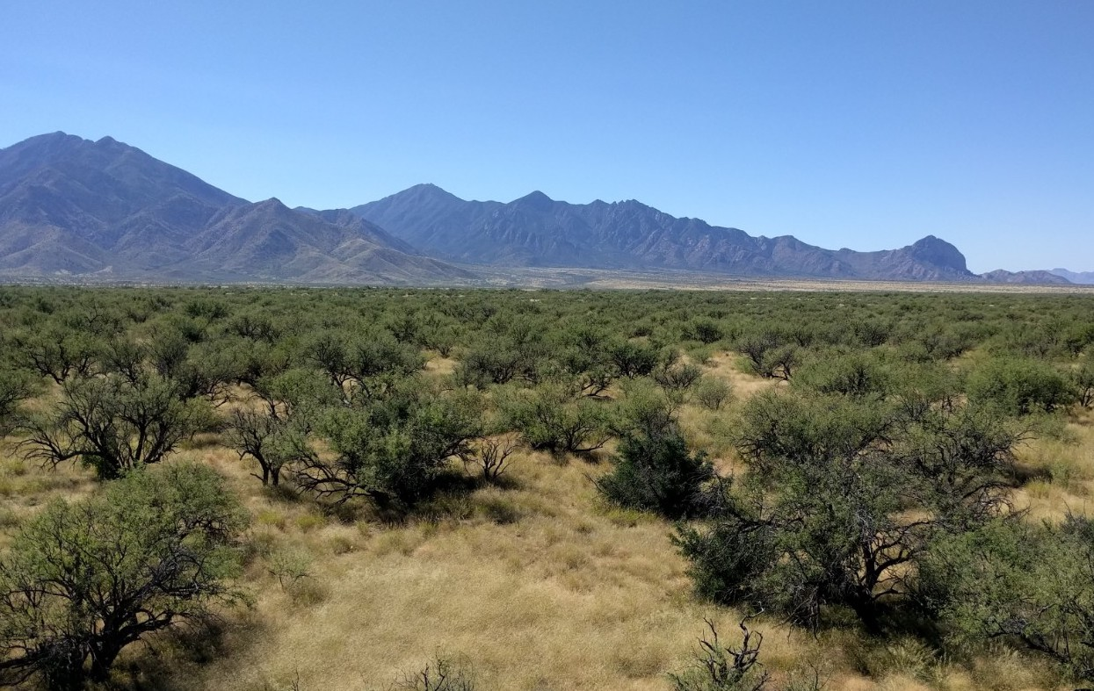
Today’s data
https://ameriflux.lbl.gov/sites/siteinfo/US-SRM

Slide 7
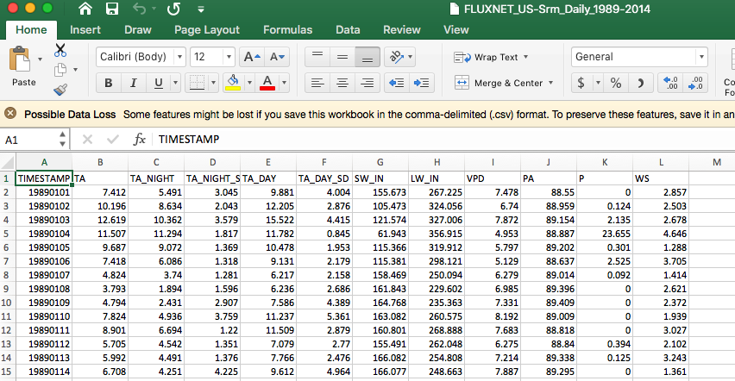
Today’s data
https://ameriflux.lbl.gov/sites/siteinfo/US-SRM

Slide 8
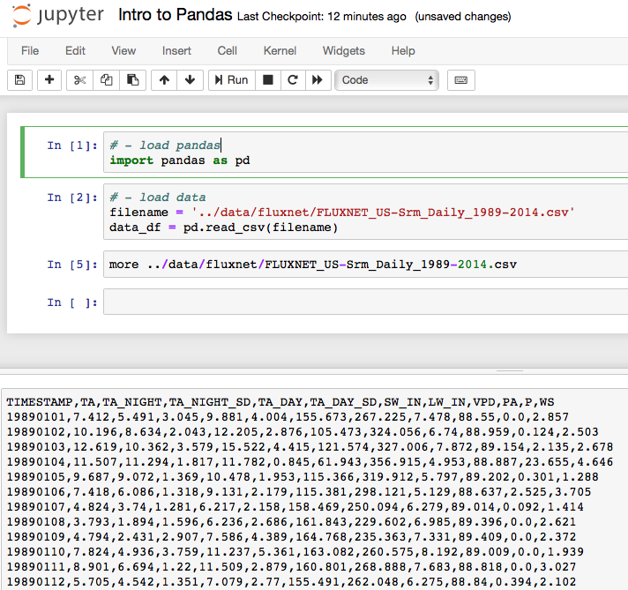
Take a look at file contents in Jupyter Notebook

Slide 9
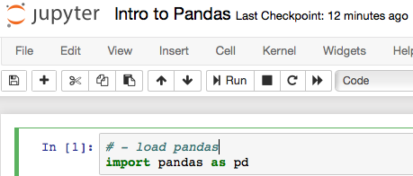
import pandas

Slide 10
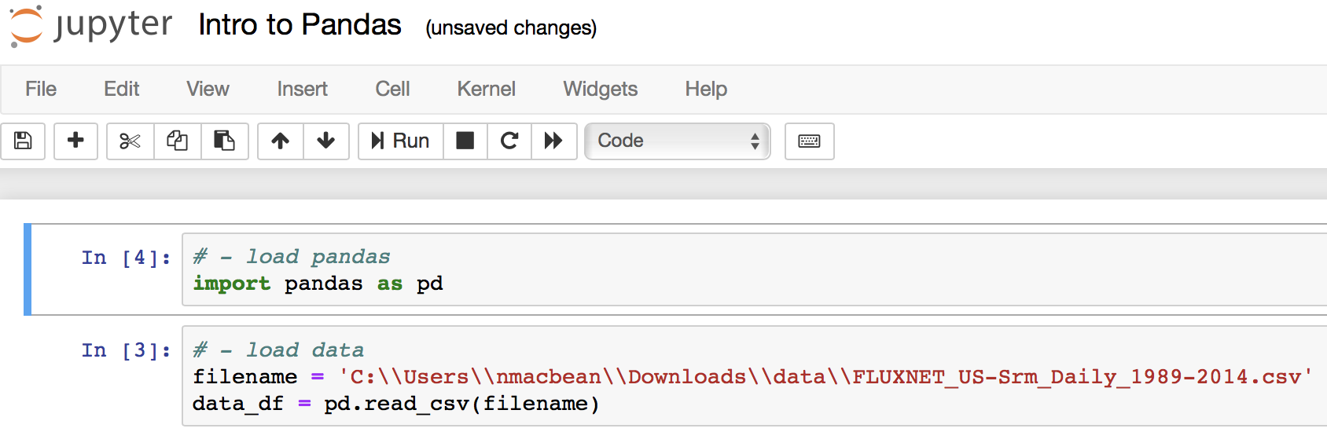
Loading pandas and reading .csv files

Slide 11
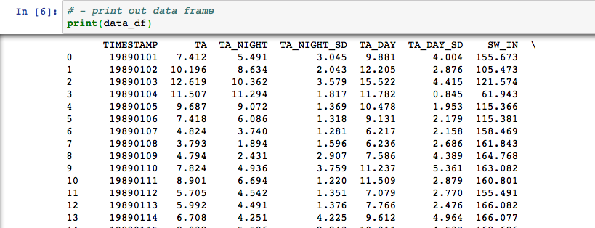
Take a look at the data: print()

Slide 12
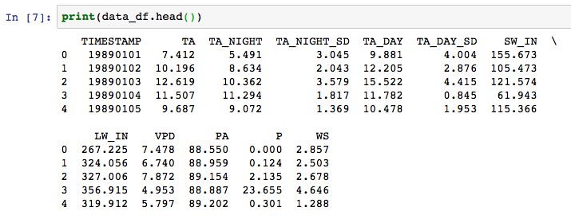
Take a look at the data / “query” the data → more useful command: df.head()
Row index

Slide 13
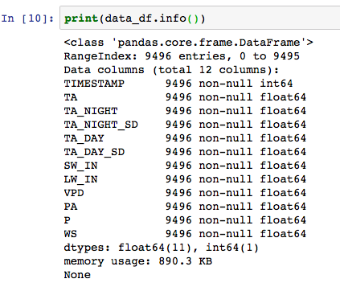
Take a look at the data → more useful command: df.info()

Slide 14
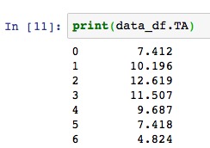
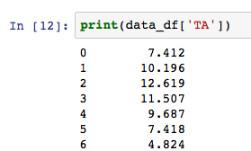
Two ways to access individual columns

Slide 15
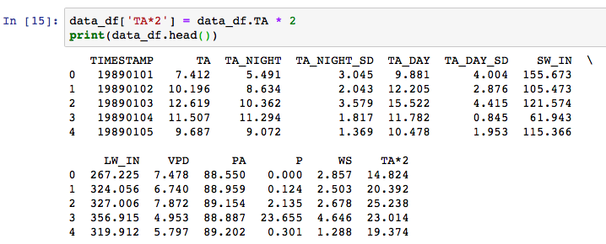
Adding new columns and arithmetic on columns with numerical data
Simply add a new column with a given heading like this…
Simple arithmetic on columns is easy…

Slide 16
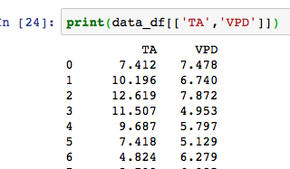
Selecting multiple columns
Need two square brackets:
[[…]]

Slide 17
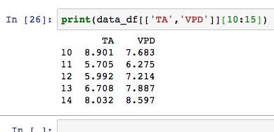
Accessing rows → same slicing as before
Square brackets with index comes after the column square brackets

Slide 18
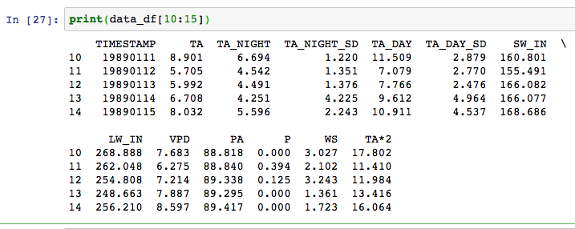
Selecting all columns for one row

Slide 19
Today’s assignment
Load pandas
Open the US-Srm .csv file (more on that next slide…) and save to a variable (e.g. data_df, but it can be called anything)
Query what’s in the file → answer these questions in a markdown box in your Jupyter Notebook:
What are the column headings?
How many data points are there in each column?
What is the data type and is it the same in all columns?
Print out the 1st 5 lines of the “TA” (daily air temp) column using both methods we have learned
We have TA_DAY and TA_NIGHT as two columns representing day and nighttime temperature. What plot would we use if we wanted to plot both curves on the same plot for the 1st year of data (hint: from the filename we know this is daily data)?
Plot this plot, with a legend, labels and a title
What type of plot would we need if we wanted to see the relationship between “TA” (daily air temp.) and “VPD” (vapor pressure deficit)?
Plot this plot with labels and a title

Slide 20
Today’s assignment
EXTRA if you’re not new to Python: replot the plot you have just created, but change the size of the markers to be smaller and add a fine lined marker edge with a black edgecolor.
What do you notice about the patterns in the data when you make the marker size smaller?

Slide 21
Today’s assignment: data file
Download the data.zip file and it *should* unzip this time!
Inside you will find the file: FLUXNET_US-Srm_Daily_1989-2014.csv

